Slide 1
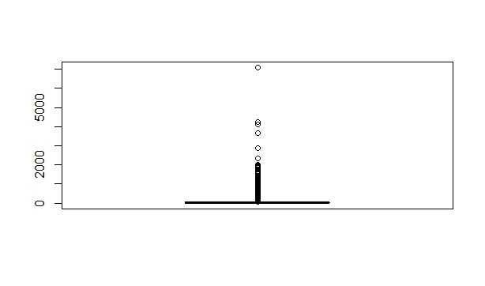
Info from the dataset
This transaction column has all the transaction includes Internet Banking, Paymnets, Phone Banking, POS and SALES-POS transactions

Slide 2
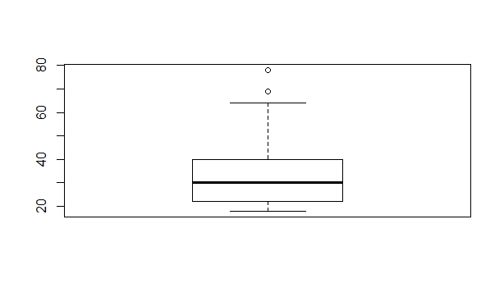
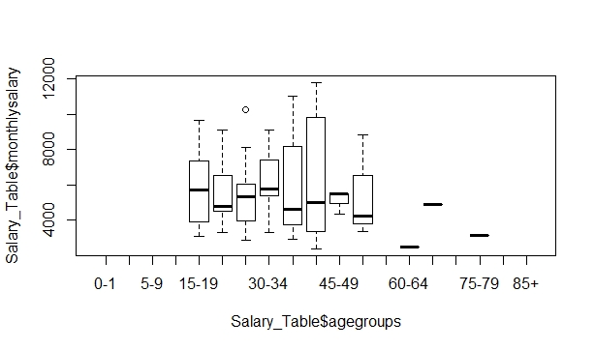
Detecting Outliers in Age Column
As it seen below, after age 67, the box plot is going to show as a outlier. But in the real world, the bank can have customers who are above 67 years old, hence, any manipulation will be used to deal with them.

Slide 3
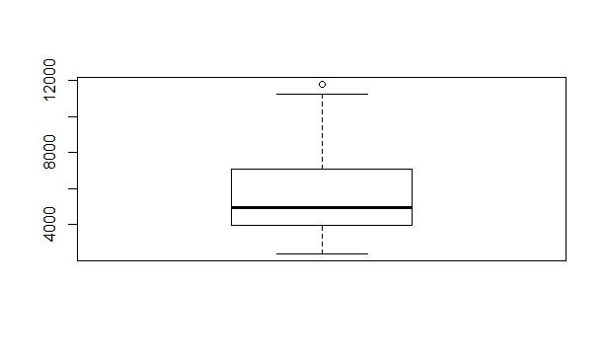
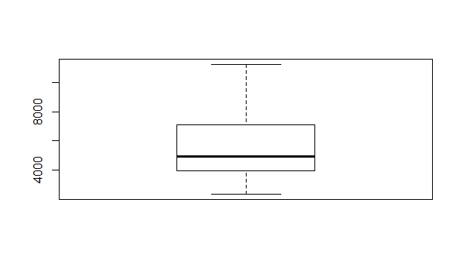
Detecting Outliers in Monthly Salary Column before treatment after treatment

Slide 4
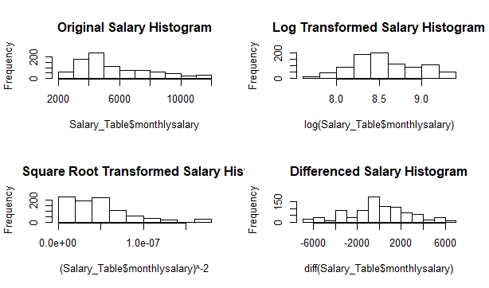
In this section, for the salary information, different method of the normalisations will be applied. They will be compared using histogram plots.

Slide 5
Final Results
As it seen above, differencing helped the age distribution to distribute normally. After that assumption, further statistical analysis's can be applied. For instance, to analyse whether the mean difference between male and female’s salaries is zero or not, paired sample t-test can be used. For this procedure, there are 4 main assumptions and one of them is the dependent variable should be approximately normally distributed and the other one is the dependent variable should not contain any outliers

